Slide 1

CPE 431/531 Chapter 5 – Large and Fast: Exploiting Memory Hierarchy
Dr. Rhonda Kay Gaede

Slide 2
5.1 Introduction
Programmers always want ___________ amounts of _____ memory. Caches give that __________
Principle of Locality
Temporal Locality - ________________________________________
_______________
Spatial Locality - _ _
_ _
Build a memory _ _.

Slide 3
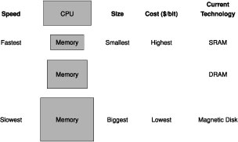
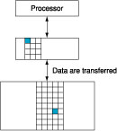
5.1 Cache Terminology
Data is copied between only _ _ levels at a time.
The minimum data unit is a _ .
If the data appears in the upper level, this situation is called a . The data not appearing in the upper level is called a .

Slide 4
5.1 More Terminology
The _ _ is the fraction of memory accesses found in the upper level.
The _ _ is the fraction of memory accesses not found in the upper level.
The _ _ is the time to access the upper level of the memory hierarchy.
The _ _ is the time to replace a block in the upper level with the corresponding block from the lower level, plus the time to deliver this block to the processor.

Slide 5
5.2 Memory Technologies
RAM ( )
0.5ns – 2.5ns, $2000 – $5000 per GB
RAM ( )
50ns – 70ns, $20 – $75 per GB
disk
5ms – 20ms, $0.20 – $2 per GB
Ideal memory
Access time of ____
Capacity and cost/GB of _

Slide 6
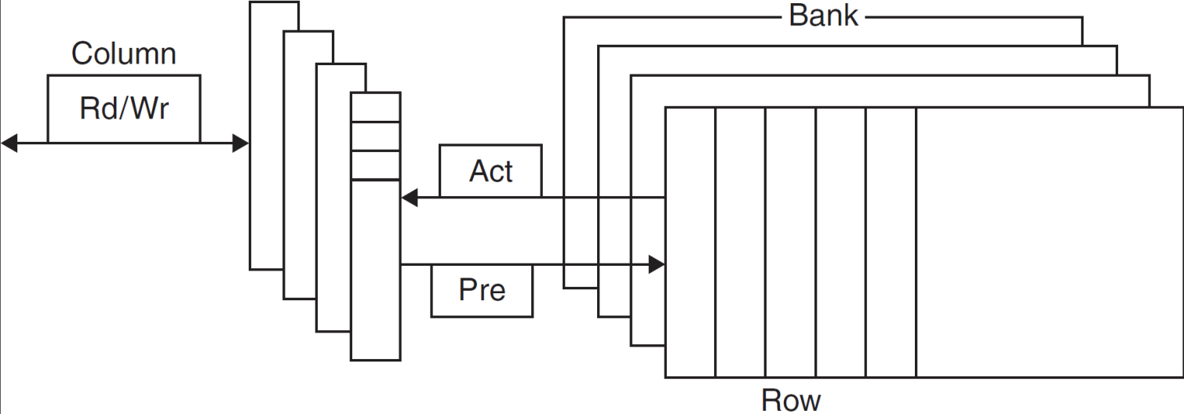
5.2 DRAM Technology
Data stored as a in a _
Single used to access the ______
Must periodically be ____________
_____ contents and ______ back
Performed on a DRAM “____”

Slide 7
5.2 Advanced DRAM Organization
Bits in a DRAM are organized as a ________________ ______
DRAM accesses an _________ _____
_______ mode: supply ______________ words from a ____ with _________ ________
_______ data rate (DDR) DRAM
Transfer on _______ and ________ clock edges
______ data rate (QDR) DRAM
Separate DDR _______ and _________

Slide 8
5.2 DRAM Generations
Year | Capacity | $/GB
1980 | 64Kbit | $1500000
1983 | 256Kbit | $500000
1985 | 1Mbit | $200000
1989 | 4Mbit | $50000
1992 | 16Mbit | $15000
1996 | 64Mbit | $10000
1998 | 128Mbit | $4000
2000 | 256Mbit | $1000
2004 | 512Mbit | $250
2007 | 1Gbit | $50

Slide 9
5.2 DRAM Performance Factors
____ ________
Allows _______ words to be read and refreshed in ________
______________ ______
Allows for ____________ accesses in bursts without needing to send _____ ________
Improves _________
______ _________
Allows _____________ access to _________ DRAMs
Improves __________

Slide 10
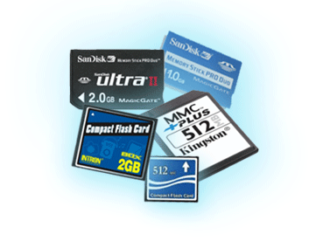
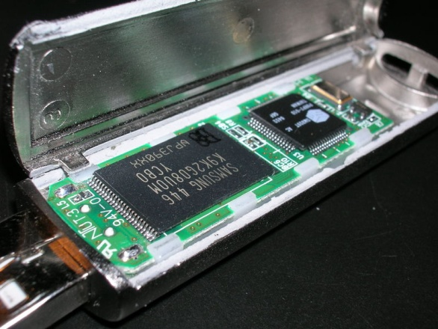
5.2 Flash Storage
____________ semiconductor storage
___× – ______× faster than _____
________, ______ power, more _______
But more $/GB (between _____ and ______)

Slide 11
5.2 Flash Types
____ flash: bit cell like a ____ gate
________ read/write access
Used for ___________ memory in __________ systems
_____ flash: bit cell like a _____ gate
________ (bits/area), but _______________ access
___________ per GB
Used for ____ _____, ______ ________, …
Flash bits wears out after _______ of accesses
Not suitable for direct ____ or _____ replacement
_____ _________: ______ data to less used blocks

Slide 12
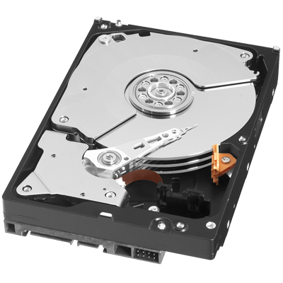
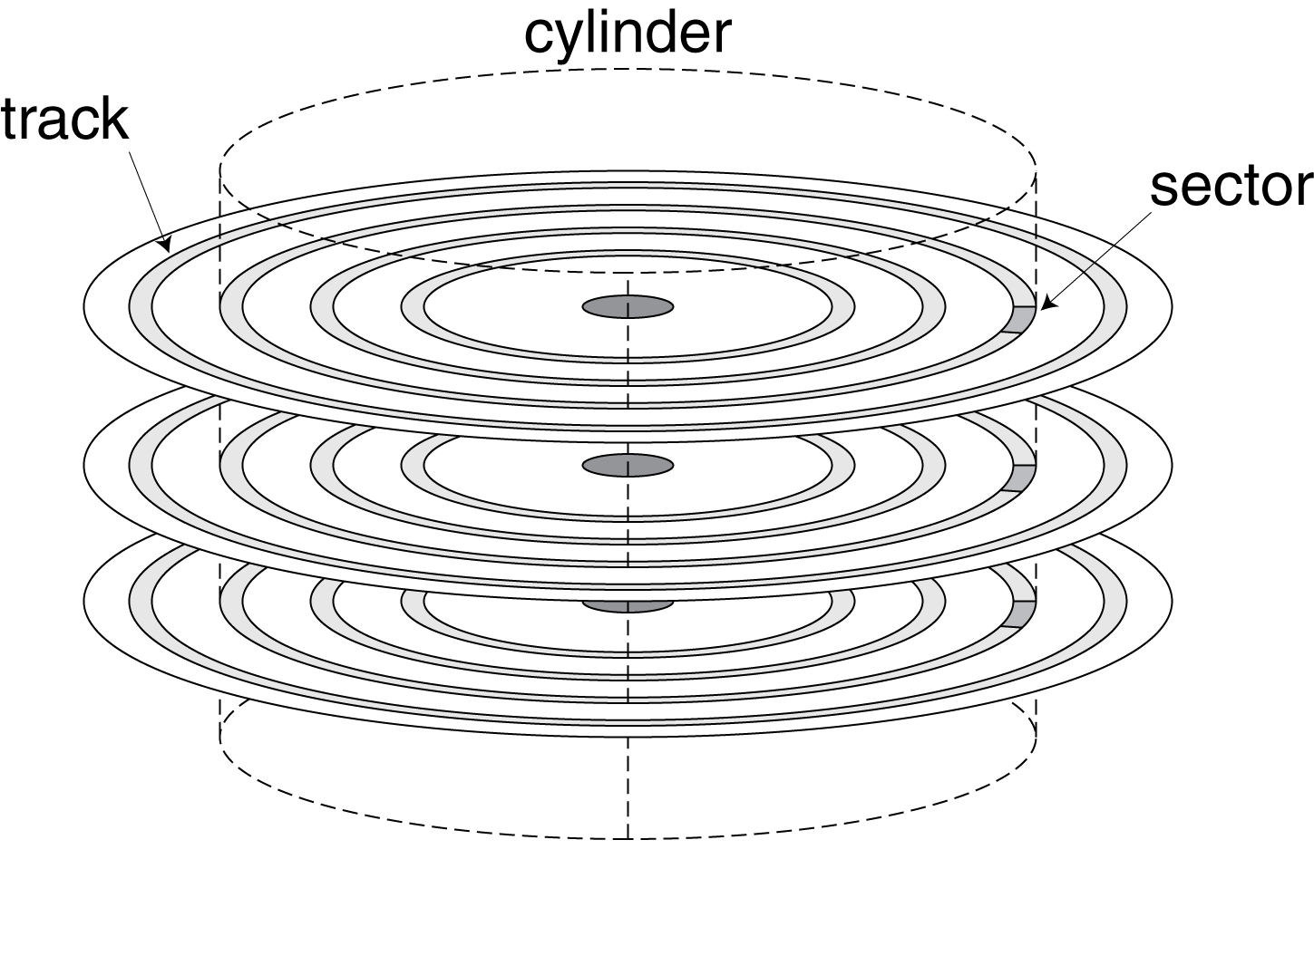
5.2 Disk Storage
_____________, __________, __________ storage

Slide 13
5.2 Disk Sectors and Access
Each ______ records
Sector ___
Data (____ bytes, ______ bytes proposed)
______ correcting code (ECC)
Used to hide ________ and recording ______
______________ fields and gaps
Access to a ______ involves
_________ delay if other accesses are pending
_____: move the heads
__________ latency
Data ________
___________ overhead

Slide 14
5.2 Disk Access Example
Given
512B sector, 15,000rpm, 4ms average seek time, 100MB/s transfer rate, 0.2ms controller overhead, idle disk
Average read time
If actual average seek time is 1ms

Slide 15
5.2 Disk Performance Issues
Manufacturers quote _________ seek time
Based on ____ _________ seeks
__________ and ___ ______________lead to smaller _______ average seek times
Smart disk ____________ allocate ________ sectors on disk
Present ________ sector interface to host
SCSI, ATA, SATA
Disk drives include _______
_________ sectors in anticipation of access
Avoid _____ and ____________ _____

Slide 16
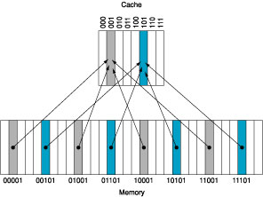
5.3 Burning Question
How do we know whether a data item is in the cache?
If it is, how do we ____ it?
The simplest scheme is that each item can be placed in _________ one place (_______ mapping).
Mapping

Slide 17
5.3 Accessing a Cache
Index | V | Tag | Data
000
001
010
011
100
101
110
111
22
26
22
26
16
3
16
18
16

Slide 18
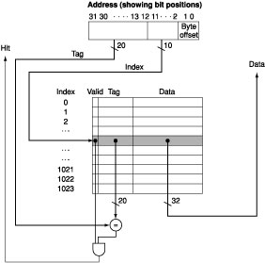
5.3 Mapping Implemented in Hardware

Slide 19
5.3 Total Storage Required
Example: How many total bits are required for a direct-mapped cache with 16 KB of data and four-word blocks, assuming a 32-bit address?

Slide 20
5.3 Mapping an Address to a Multiword Cache Block
Consider a cache with 64 blocks and a block size of 16 bytes. What block number does byte address 1200 map to?

Slide 21
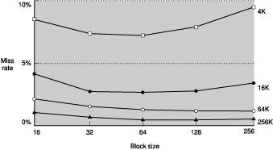
5.3 Miss Rate versus Block Size

Slide 22
5.3 Handling Cache Misses
Instruction Cache Miss
1. Send the original PC value (current PC – 4) to the memory.
2. Instruct main memory to perform a read and wait for the memory to complete its access.
3. Write the cache entry, putting the data from memory in the data portion of the entry, writing the upper bits of the address into the tag field and turn the valid bit on.
4. Restart the instruction execution at the first step, which will refetch the instruction, this time finding it in the cache.

Slide 23
5.3 Handling Writes
Suppose on a store instruction, we wrote the data into only the data cache (and not _______________
________).
Then the cache and main memory are said to be ____________
Solution A: __________________________ (______ _________)
Problem: __________________________
Remediation: ___________________
Solution B: _________________________________ (_____ _____)

Slide 24
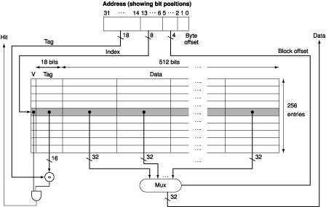
5.3 An Example Cache
This processor has a __ stage pipeline.
When operating at peak speed, the processor can request both an ________ word and a _____ word on every clock cycle.
Separate __________ and _____ caches are used, each with __ words and __-word blocks.
For writes, the FastMATH offers both ___________ and __________, letting the ___ decide.
The Intrinsity FastMATH Processor is a fast ___________ processor that uses the MIPS architecture and a ________ cache implementation.

Slide 25
5.4 Measuring and Improving Cache Performance
CPU time = (_______________________ + __________________) x ______________
Memory-stall clock cycles = _______________ + ______________
Read-stall cycles =
Write-stall cycles =
Memory-stall clock cycles =
Calculating Cache Performance
i_{miss} = 2 %, d_{miss} = 4 %, CPI_{perfect} = 2, miss penalty = 100 cycles, 36 % loads and stores

Slide 26
5.4 Impact of Increased Clock Rate
Suppose the processor in the previous example _______ its clock rate, making the miss penalty ________.
Total miss cycles per instruction = _______.
Total CPI
Performance with fast clock compared to performance with slow clock

Slide 27
5.4 Average Memory Access Time
To capture the fact that the time to ______ ____ for both ____ and ______ affects performance, designers sometimes use average memory access time (AMAT) as a way to examine _________ _____ ______.
AMAT = Time for a hit + Miss rate x Miss penalty
Find the AMAT for a processor with CT = 1 ns, Miss penalty = 20 cycles, Miss rate = 0.05/instruction, Cache access time = 1 cycle. Assume that read and write miss penalties are the same and ignore other write stalls.

Slide 28
5.4 Flexible Placement Reduces Cache Misses
One Extreme - direct mapped -
Middle Range - set associative -
Other Extreme - fully associative -
Set associative mapping

Slide 29
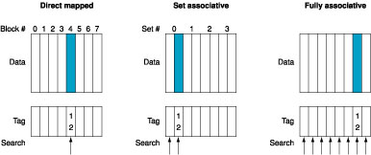
5.4 Conceptual View of Set Associativity
One Extreme - direct mapped -
Middle Range - set associative -
Other Extreme - fully associative -
Set associative mapping

Slide 30
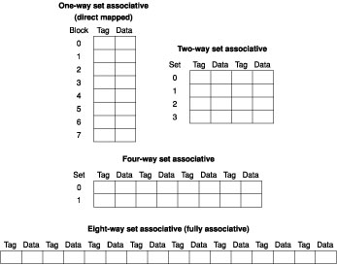
5.4 Pseudo-Implementation View of Set Associativity

Slide 31
5.4 Misses and Associativity
Look at three small caches (four one word blocks): Address sequence: 0, 8, 0, 6, 8
a. fully associative b. two-way set associative c. direct mapped

Slide 32
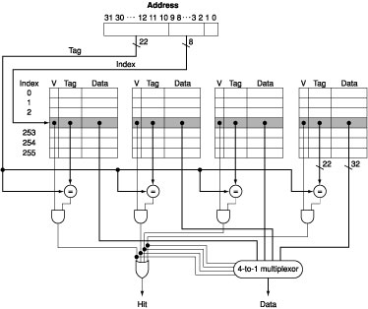
5.4 Locating a Block in the Cache
Which block do we replace?

Slide 33
5.4 Tag Size Considerations
Size of Tags versus Set Associativity
For a cache with 4K blocks, a 32-bit address with 0 bits for block and byte offsets, find the #sets, #tag bits for 1, 2, 4 and fully associative organizations

Slide 34
5.4 Performance of Multilevel Caches
Example:
CPI_{base} = 1.0, CR = 4 GHz
Mem_{access} = 100 ns, L1inst_{miss} = 2 %
L2_{access} = 5 ns, L2_{miss} per instruction = 0.5 %

Slide 35
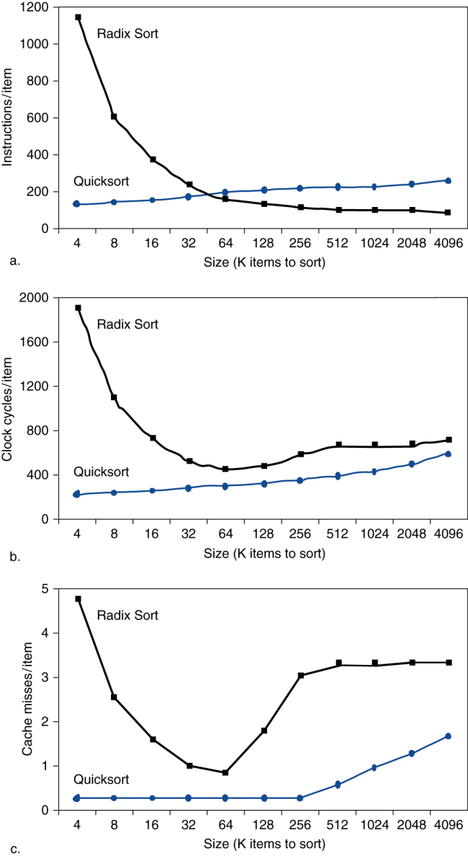
5.4 Interactions with Software
Misses depend on memory access patterns
Algorithm behavior
Compiler optimization for memory access

Slide 36
5.4 Software Optimization via Blocking
Goal: maximize accesses to data before it is replaced
Consider inner loops of DGEMM:
Blocked algorithms operate on submatrices or blocks rather than entire rows or columns of an array
for (int j = 0; j < n; ++j)
{
double cij = C[i+j*n]; /* cij = C[i][j] */
for( int k = 0; k < n; k++ )
cij += A[i+k*n] * B[k+j*n]; /* cij += A[i][k]*B[k][j] */
C[i+j*n] = cij; /* C[i][j] = cij */
}

Slide 37
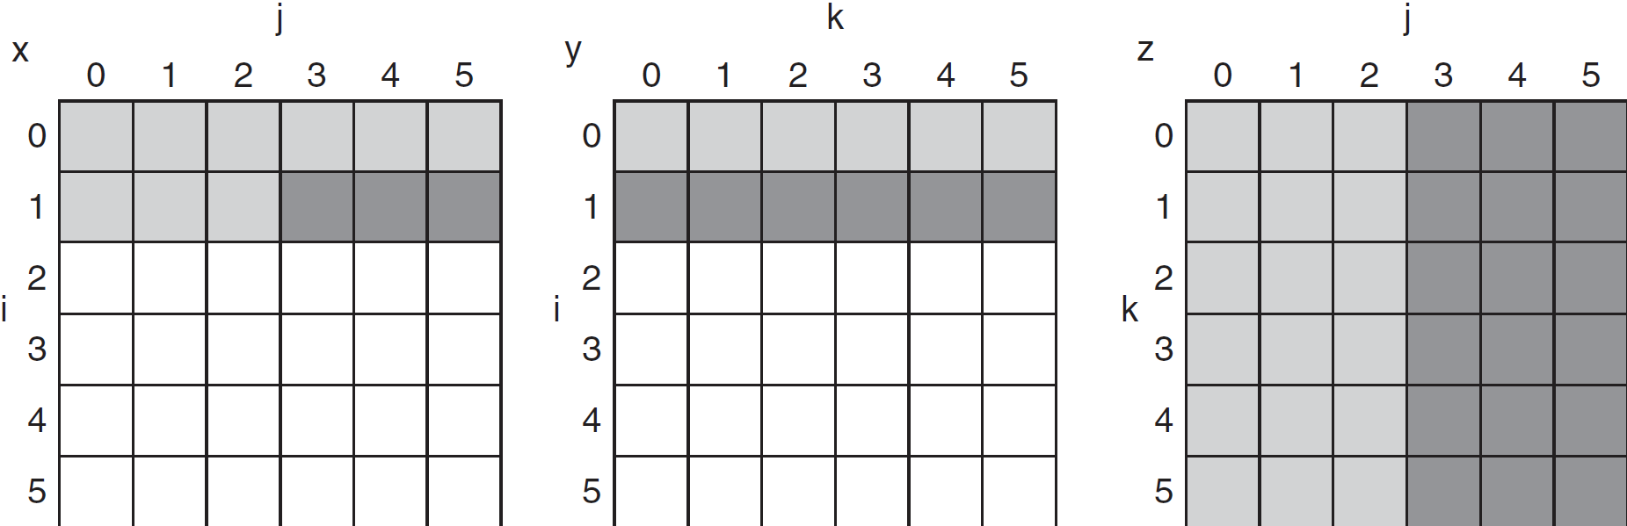
5.4 Array Access Patterns
older accesses
new accesses

Slide 38
5.4 Cache Blocked DGEMM
1 #define BLOCKSIZE 32
2 void do_block (int n, int si, int sj, int sk, double *A, double
3 *B, double *C)
4 {
5 for (int i = si; i < si+BLOCKSIZE; ++i)
6 for (int j = sj; j < sj+BLOCKSIZE; ++j)
7 {
8 double cij = C[i+j*n];/* cij = C[i][j] */
9 for( int k = sk; k < sk+BLOCKSIZE; k++ )
10 cij += A[i+k*n] * B[k+j*n];/* cij+=A[i][k]*B[k][j] */
11 C[i+j*n] = cij;/* C[i][j] = cij */
12 }
13 }
14 void dgemm (int n, double* A, double* B, double* C)
15 {
16 for ( int sj = 0; sj < n; sj += BLOCKSIZE )
17 for ( int si = 0; si < n; si += BLOCKSIZE )
18 for ( int sk = 0; sk < n; sk += BLOCKSIZE )
19 do_block(n, si, sj, sk, A, B, C);
20 }

Slide 39
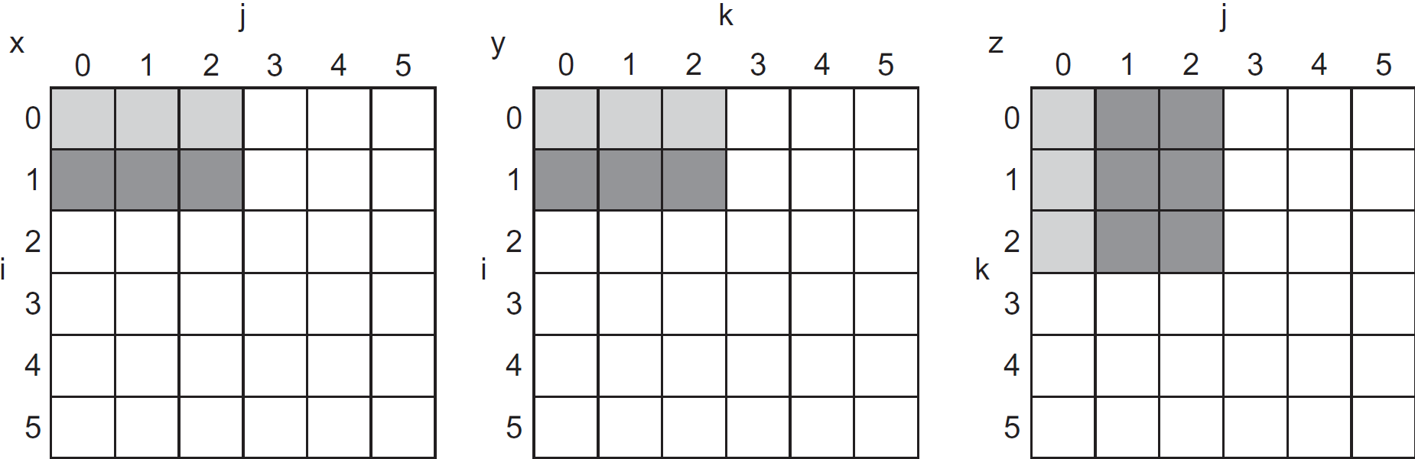
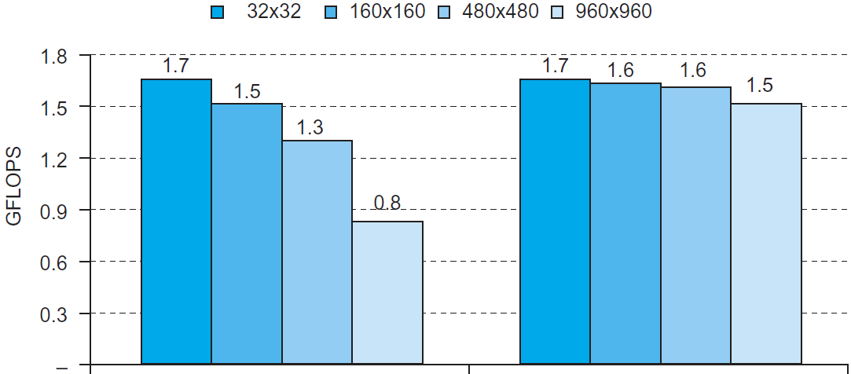
5.4 Blocked DGEMM Access Pattern

Slide 40
5.5 Dependable Memory Hierarchy
Two states of service
1. Service accomplishment -
2. Service interruption –
Transitions from 1 to 2 are ___________, transitions from 2 to 1 are _____________.
Failures can be ___________ or ______________.
Reliability is a measure of the continuous service accomplishment, the metric is _____________________.
Availability is a measure of the service accomplishment with respect to the alternation between the two states of accomplishment and interruption.

Slide 41
5.5 MTTF vs. AFR for Disks
Some disks today are quoted to have a 1,000,000-hour MTTF. As 1,000,000 hours is 114 years, it would seem like they practically never fail. Warehouse scale computers that run Internet services such as Search might have 50,000 servers. Assume each server has 2 disks. Use AFR to calculate how many disks we would expect to fail per year.

Slide 42
5.5 Availability Considerations
To increase _____, you can improve the _______ of components or design systems to _______ operation in the presence of components that have ______.
Three techniques
Fault avoidance
Fault tolerance
Fault forecasting
We also need to work on decreasing _____

Slide 43
5.5 Single Error Detection - Parity
Hamming distance
Number of ___ that are __________ between two bit patterns
Minimum distance = __ provides single bit error detection
e.g. _____ code
Minimum distance = __ provides ______ error correction, ___ ____ error detection

Slide 44
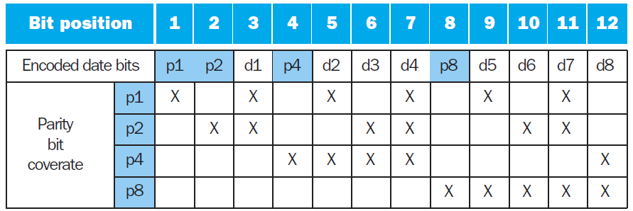
5.5 Encoding Single Error Correcting Hamming Code
To calculate Hamming code:
Number bits from 1 on the left
All bit positions that are a ______ __ __ are ______ bits
Each _______ bit checks certain _____ bits:

Slide 45
5.5 Decoding Single Error Correcting Hamming Code
______ of parity bits indicates which bits are __ _____
Use numbering from __________ procedure
E.g.
Parity bits = ______ indicates ___ ______
Parity bits = ______ indicates bit ___ was flipped

Slide 46
5.5 SEC/DEC Hamming Code
Add an additional parity bit for the ______ ____ (p_{n})
Make Hamming distance = __
Decoding:
Let H = SEC parity bits
H even, p_{n} even, __________
H odd, p_{n} odd, ____________________________________
H even, p_{n} odd, ________________
H odd, p_{n} even, _______________________________
Note: ECC DRAM uses SEC/DEC with 8 bits protecting each 64 bits

Slide 47
5.6 Virtual Machines Redux
First developed in the 1960s, they have remained an important part of _________ computing and have recently gained popularity due to
Increasing importance of ________ and ________
The failures in _________ and _________ of standard operating systems
The _______ of a single computer among many related users
The dramatic increase in ___ ____ of processors
Broadest Definition
Includes basically all _________ methods that provide a standard software interface, like the ____________________________
Our Definition
Provide a complete ____________ environment at the ____ level

Slide 48
5.6 Virtual Machine Basics
System virtual machines present the illusion that users have an _____ _______ to themselves, including a copy of the _________ ______.
With a VM, multiple OSes all ____ the ________ resources.
The software that supports VMs is called a _____ _______ ______ (VMM) or _________.
The underlying hardware is called the ____, sharing resources among the ______ VMs.

Slide 49
5.6 Virtual Machine Ancillary Benefits
Our interest is primarily in improving ___________
Other benefits include
________ _______: a typical deployment might be some OSes running legacy OSes, many running the current stable OS release, and a few testing the next OS release.
________ ________: Consolidate the number of servers. Some VMMs support migration of a running VM to a different computer, either to balance load or to evacuate from failing hardware.

Slide 50
5.6 Requirements of a Virtual Machine Monitor
Guest software should behave on a VM exactly as if it were running on the _____ _______, except for _________________ behavior or limitations of _____ _________ shared by multiple VMs.
Guest software should not be able to ______ __________ of real system resources directly.
At least ___ processor modes, ______ and ____.
A _________ subset of instructions available only in ______ mode, all system ___________ must be controllable only via these instructions.

Slide 51
5.7 Virtual Memory
The ___ ______ can act as a _____ for the __________ storage.
Historically, two motivations for virtual memory
_________________________________________
__________________________________________
Virtual memory implements the ____________ of a program’s address space to ________________.
This translation process enforces ______________ of a program’s address space from other programs.

Slide 52
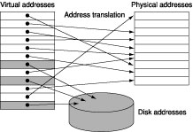
5.7 Virtual Memory Terminology
A virtual memory ______________ is called a _______.
A virtual memory _________ is called a ______
_________.
Each _______ address is translated to a ________ address.
This process is called ______________________.

Slide 53
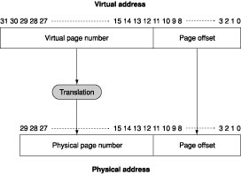
5.7 Virtual Memory Facts
A virtual _______ is broken into a virtual ____ _______ and a ____ ______.
A page fault takes _______ of cycles to process
Pages should be _____ enough to ________ the high access time, though ________ systems are going smaller.
_____ __________ placement of pages is _______.
Page faults can be handled in ________.
Virtual memory uses ________.

Slide 54
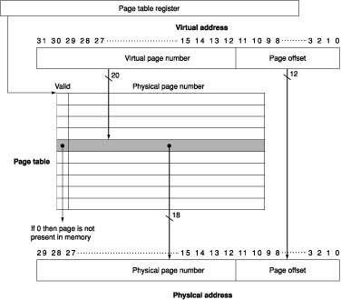
5.7 Virtual Memory Mapping
Pages are _______ by using a
____ _____ that ______ memory.
Each _______ has its own
____ ______.
The ____ _____ register points
to the _________ of the ____ _____.
A ____ table is too _________,
___________ page tables are used.
The ______ of a _______ consists
of the ____ _____ ______, ______ ______ and ________.

Slide 55
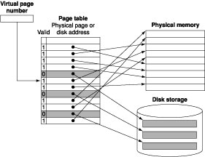
5.7 Page Faults
The ________ ______ manages page replacement.
The ________ ______ usually creates the _____ __ ___ for all of the pages of a process when it creates the process, this space is called _____ ______
A data structure records where ____ ____ is stored on disk. Another data structure tracks which _________ and which ____ ________ use each ______ ____.
On a page fault, the ____________
____ page is evicted.
Consider 10, 12, 9, 7, 11, 10, then 8

Slide 56
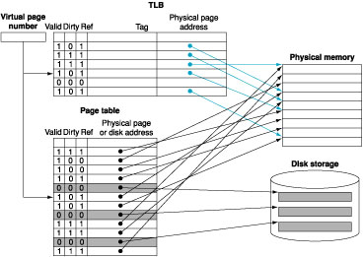
5.7 Making Address Translation Fast: The TLB
With virtual memory, you need ___ memory accesses, one extra for the ________.
Add a ____ to keep
track of _____ translations.
It’s called a _________
_______ _____ (TLB).
A TLB ____ may or may
not be a ____ _____
TLB characteristics
size: ________________
block size: ___________
hit time: ______________
miss penalty: ___________
miss rate: ______________

Slide 57
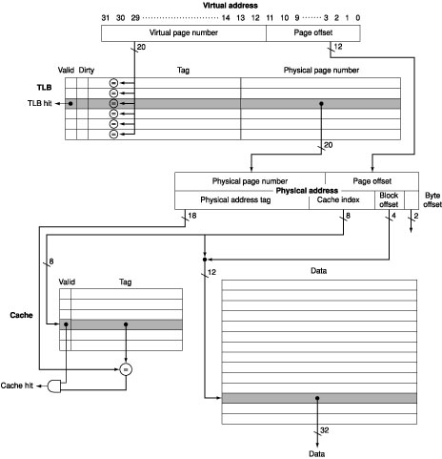
5.7 The Intrinsity FastMATH TLB

Slide 58
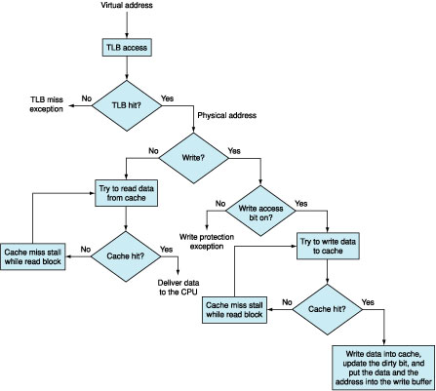
5.7 Processing a read or write-through

Slide 59
5.4 Overall Operation of a Memory Hierarchy

Slide 60
5.7 Implementing Protection with Virtual Memory
Hardware Must Provide
At least two modes
_________________
_________________
Provide a portion of the _______ ____ that a user process can ____ but not ____
______________________________________________
Provide mechanisms whereby the processor can move between modes
_________________________
_________________________________
Software Can Help
Place the ____ ______ in the _________ address space of the __________________

Slide 61
5.7 Summary
Pages are made _______ to take advantage of _________ locality and reduce the _____ rate.
The mapping between virtual addresses and physical addresses, which is implemented in a _____ _______, is made ______ _____________so that a virtual page can be placed __________ in main memory.
The ___________ ______uses techniques, such as LRU and a reference bit, to choose which pages to ________.

Slide 62
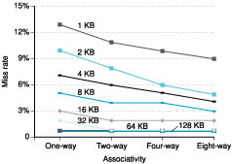
5.8 Where can a Block be Placed?
A _____ of Associativities is possible
Advantage: _________ associativity _________ miss rates.
Disadvantage: Increasing __________ increases ___ and _____ ____.

Slide 63
5.8 How is a Block Found?
Cache
_Small_ degrees of associativity are used because _large_ degrees are _expensive_
Virtual Memory
_Full_ _associativity_ makes sense because
Misses are _very_ _expensive_
_Software_ can implement _sophisticated_ replacement schemes
Full map can be easily _indexed_
_Large_ items means small number of _mappings_

Slide 64
5.8 Replace Which Block on a Cache Miss?
Cache
_______
___
Virtual Memory
___

Slide 65
5.8 What Happens on a Write?
Caches - write-back is the _______ of the _____
Virtual memory – ____________ uses write-back

Slide 66
5.8 The Three Cs
Cache misses occur in three categories:
Compulsory misses -
Capacity misses -
Conflict misses -
The ________ in designing memory hierarchies is that every _______ that __________ improves the ___ rate can also __________ affect overall performance.

Slide 67
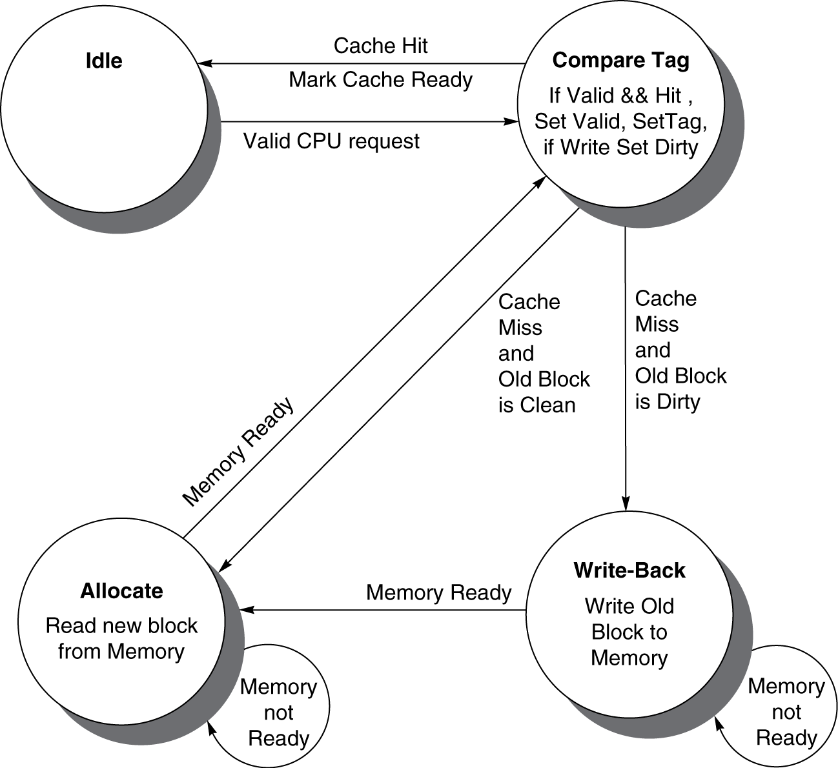
5.9 Finite State Cache Controller

Slide 68
5.10 Cache Coherence
Multiple processors commonly _____ an _______ ______
They may bring _____ into ______ and then write to their _______copies
These local copies are likely
Different from ____ _____
Different from the _____ ______ value
Example
Time step | Event | CPU A’s cache | CPU B’s cache | Memory
0 |  |  |  | 0
1 | CPU A reads X | 0 |  | 0
2 | CPU B reads X | 0 | 0 | 0
3 | CPU A writes 1 to X | 1 | 0 | 1

Slide 69
5.10 Snooping
Every cache has the _______ ______ of the block along with the block
The caches are all _________ via some __________ mechanism (___ or _______).
All cache controllers _______ or ______ on the medium to see whether or not they have a _____ of the ______ requested.
The _______ CPU broadcasts an __________ of the block.
Example
CPU activity | Bus activity | CPU A’s cache | CPU B’s cache | Memory
 |  |  |  | 0
CPU A reads X | Cache miss for X | 0 |  | 0
CPU B reads X | Cache miss for X | 0 | 0 | 0
CPU A writes 1 to X | Invalidate for X | 1 |  | 0
CPU B read X | Cache miss for X | 1 | 1 | 1

Slide 70
5.16 Concluding Remarks
The difficulty of building a memory system to keep pace with faster processors is underscored by the fact that the raw material for main memory, DRAMs, is essentially the same in all computers, fast or slow.
Multilevel caches facilitate cache optimizations.
_________________
_______________________________________________
______________
Other trends
______________________________________
___________

